Slide 1
Git
How to use it

Slide 2
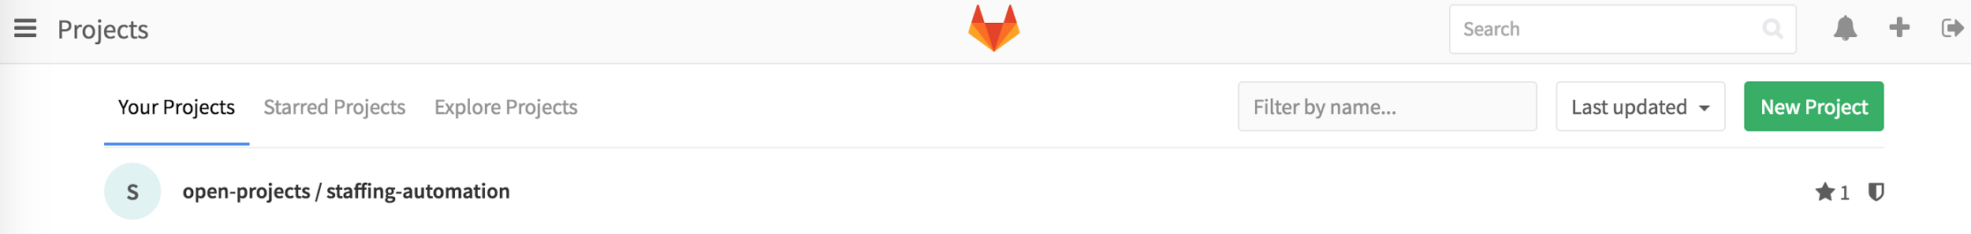
Get into GitLab
Get into the link http://gitlab.nisumlatam.com
Get your session with:
User: kodea@nisumlatam.com
Password: kodea2016

Slide 3


FORK - Create a Fork (web)
You need to create your own fork to work
Press button Fork
Then you see something like this (forked from…)

Slide 4
FORK - Clone a Fork in your PC
After you create the fork, you need to clone your fork in your computer, copy the link in HTTPS
Open the prompt (windows) or terminal (mac) to do the next steps
Clone your fork in your computer (you have two options)
a. Without a folder previously created to make the changes (you need to be positioned where you want to create the folder)
git clone [URL you want to clone HTTPS] [Folder to create]
b. With a folder to make the changes already created or exists (you need to be positioned in the folder)
git clone [URL you want to clone HTTPS]
You can see the working tree status
git status

Slide 5
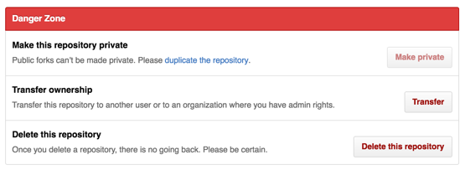
FORK - Eliminate a Fork (web)
How to eliminate a Fork
1- Go to the fork
2- Go to settings
3- Down to the final of the page, in the Danger Zone section
4- Select Delete this repository, and press this button

Slide 6
Branch - Create, erase and add a Branch
When you create a branch you can make your changes in your computer (optional), this branch looks like the fork, same files.
Create a new branch and positioned in it
git checkout -b [name of the branch]
To erase the branch checking if the branch is synchronized with the remote
git branch –d [branch]
To erase the branch without checking if the branch is synchronized with the remote (not recommended)
git branch –D [branch]
Add a branch in the remote
git push --set –upstream [remote][branch]

Slide 7
Branch - Change to a branch or List of branch
To change to another branch
git checkout [branch]
List both remote-tracking branches and local branches
git branch –a

Slide 8
Remote - Add, remove and check list of Remotes
If you already clone from the web your fork then you already has a remote
Check all the remotes existed
git remote –v
To remove a remote
git remote remove [remote to erase]
To create a remote
git remote add [remote to add] [URL]

Slide 9
Pull
To get all the information for a fork that already exists in your pc from the web to your pc you need to pull from the remote
Create the remote from the url you need to create first the remote from the web
If you need to brings all the changes to your local copy and replace
git pull [remote (from)] [branch (where)]

Slide 10
Add and Commit
To add all your changes to your fork
git add .
To add a specific file
git add [name of the file]
If you put git status, you can see this three kind of files
Changes to be commited
Change not staged for commit
Untracked files
After add the files, you need to make a commit, and add the explanation of the changes
git commit –m “Explanation of the change”

Slide 11
Push and see the commits
After you commit you need to push the information in your remote fork
Push the information from a branch
git push [remote (where)][branch (from)]
Push the information from a branch (forced)
git push [remote (where)][branch (from)] -f
To see the commits (logs)
git log

